Slide 1
Climb
We’re going to make it to the mountain top!
on
Black on Black
Blacks united to educate, motivate, innovate, create, stimulate, relate, and elevate!

Slide 2
IN ORDER TO FULLY SEE -
WE MUST TURN THE LIGHTS BLACK ON!
BE PROUD OF YOUR HERITAGE!

Slide 3
IT’S TIME TO CHANGE THE DIE-NAMICS…
CLIMB
BLACK
BLACK
ON
ON
ON

Slide 4
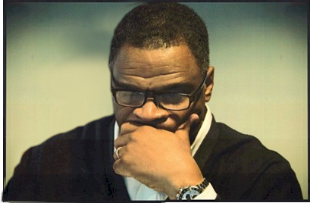
Kevin D. Sly, Ed.D.
Class is now in session!
The doctor will be with you shortly…

